Slide 1
Culture: Invented or Inherited?
Harmony, dissonance, silence: a journey through European capitals of culture
12th UNeECC Conference
8 November 2018
University of Malta
Dr Karsten Xuereb

Slide 2
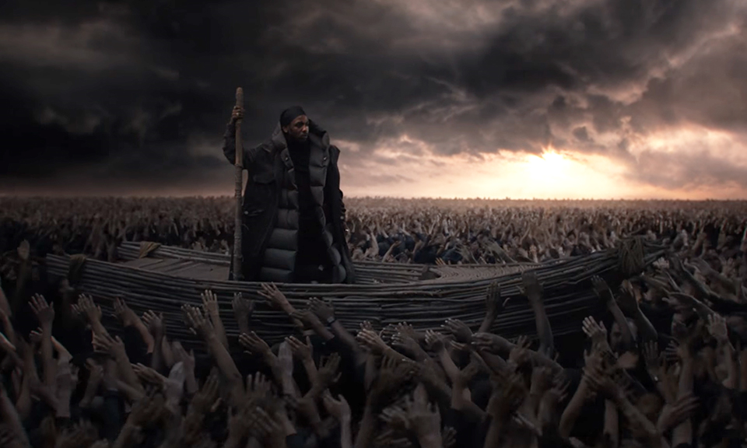
Forgotten history, forgotten legacy, / Facts of the past sure can influence our future / ‘Fore they can face the truth, my people fades to black / Back against the wall, living in a world in war. / Ignorance the number one cause of death / Knowledge and faith the only wealth worth collecting / Culture saved from the shade, Black slaves finally free.

Slide 3
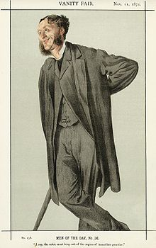

Slide 4
Ah, love, let us be true / To one another! for the world, which seems
To lie before us like a land of dreams, / So various, so beautiful, so new,
Hath really neither joy, nor love, nor light, / Nor certitude, nor peace, nor help for pain; / And we are here as on a darkling plain / Swept with confused alarms of struggle and flight, / Where ignorant armies clash by night.

Slide 5
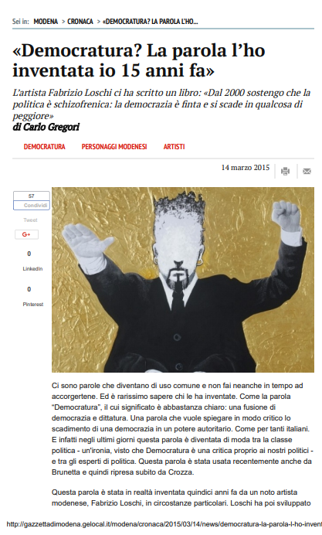

Slide 6
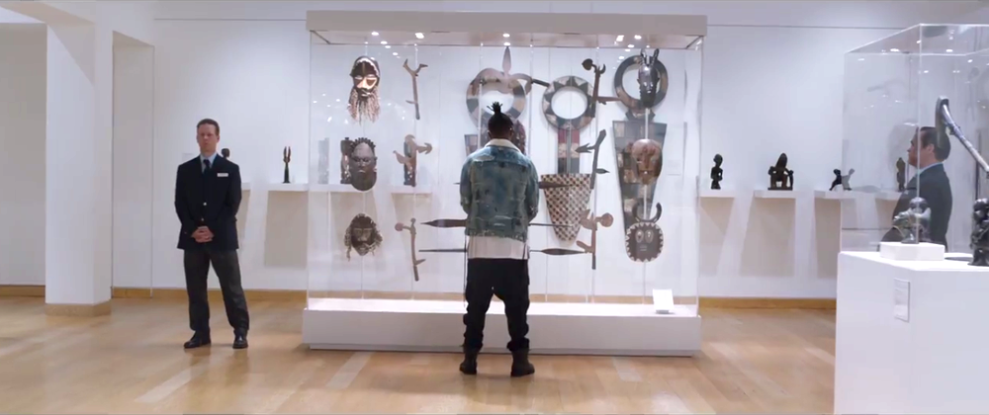

Slide 7
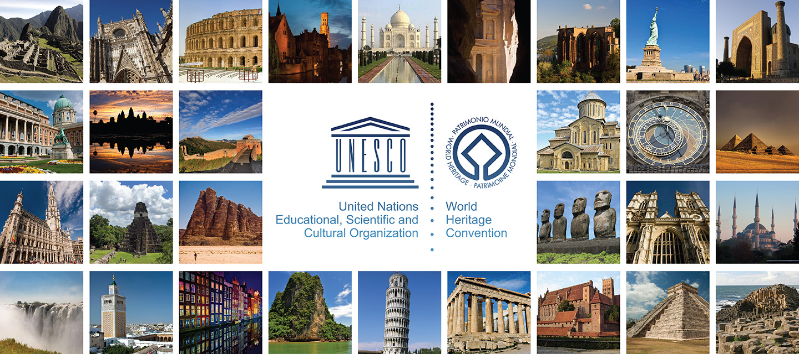

Slide 8
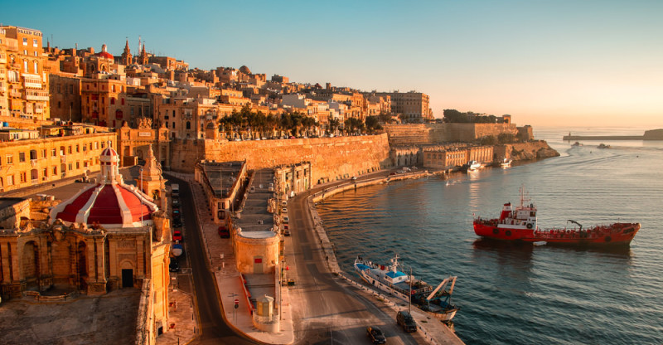

Slide 9
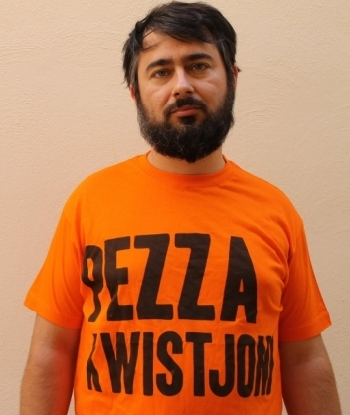

Slide 10
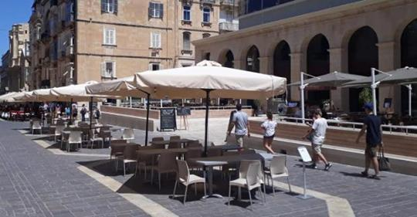

Slide 11
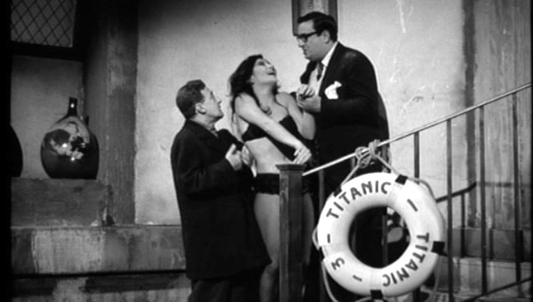

Slide 12
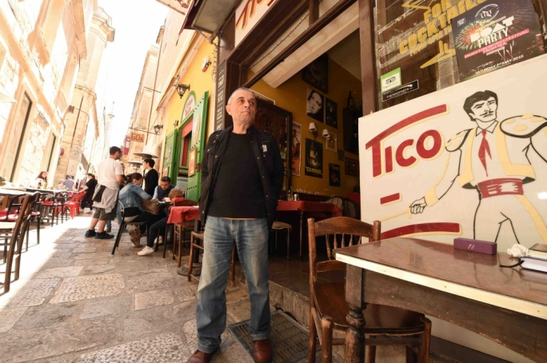

Slide 13
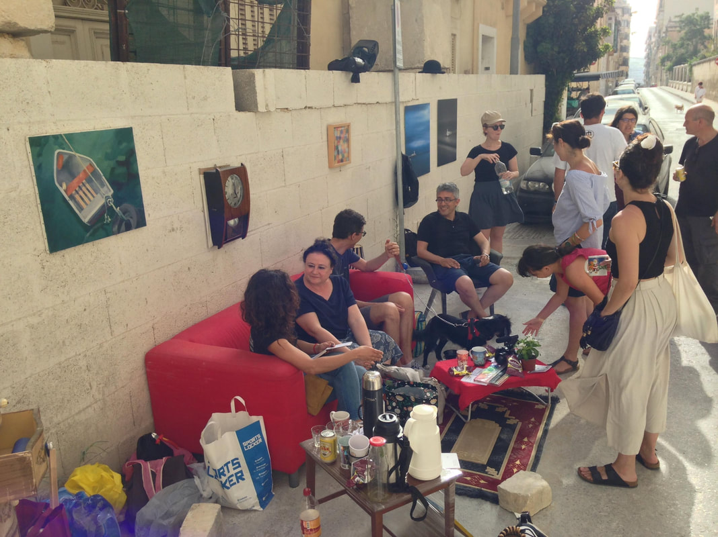

Slide 14


Slide 15
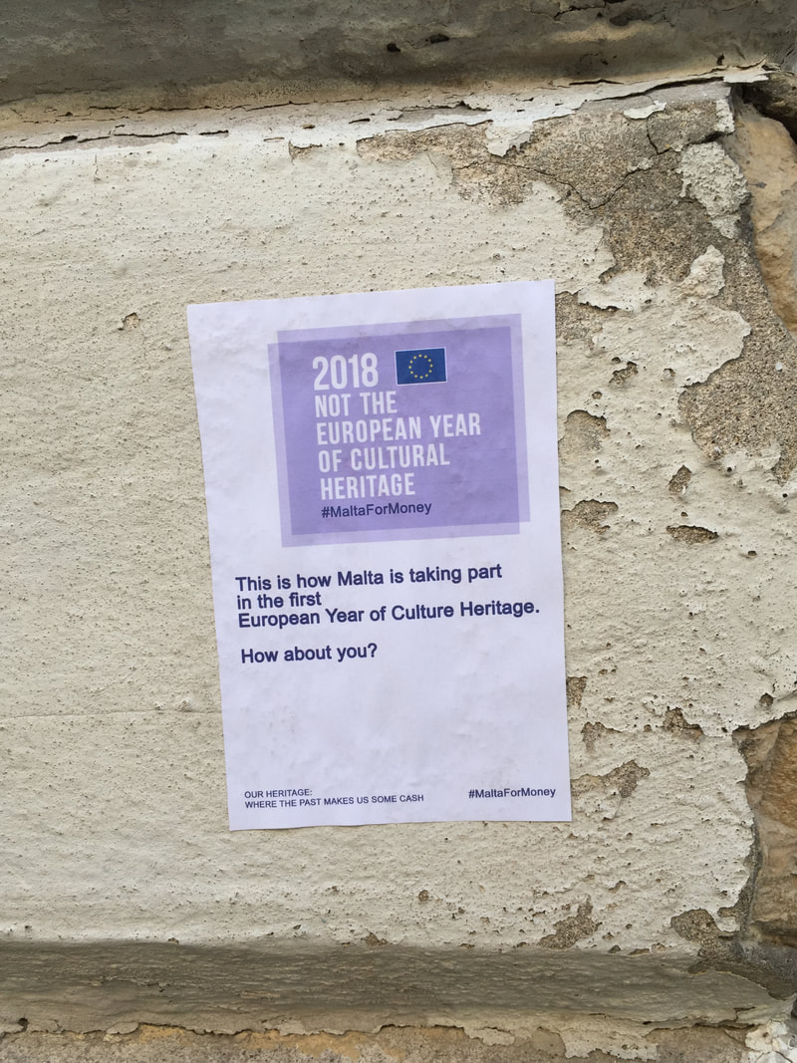

Slide 16
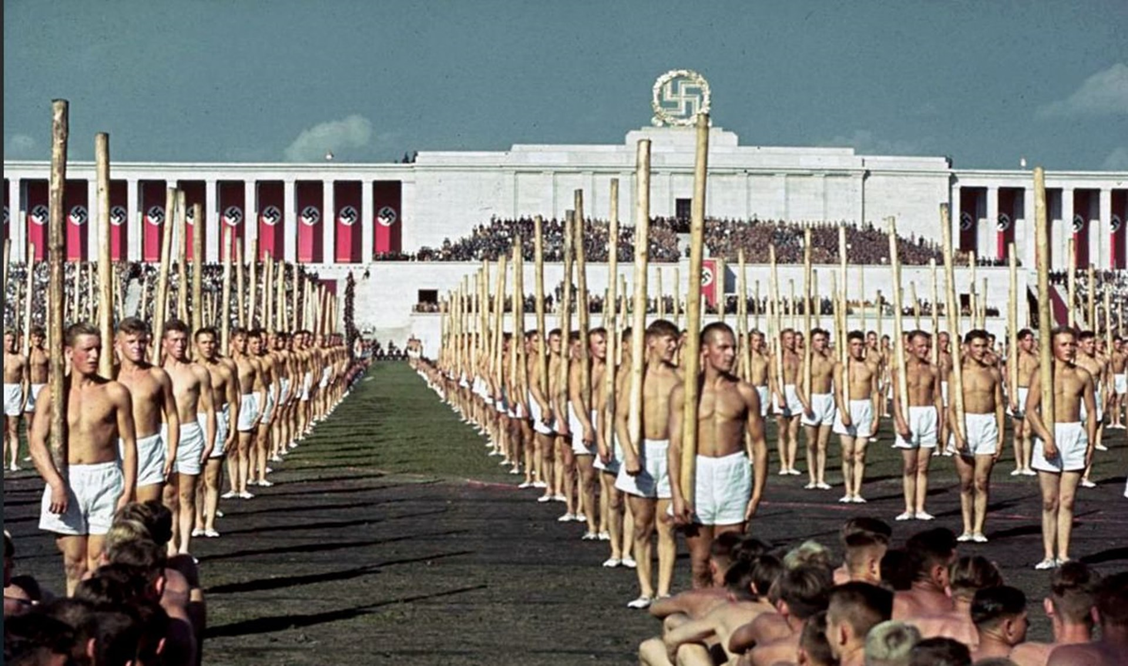

Slide 17
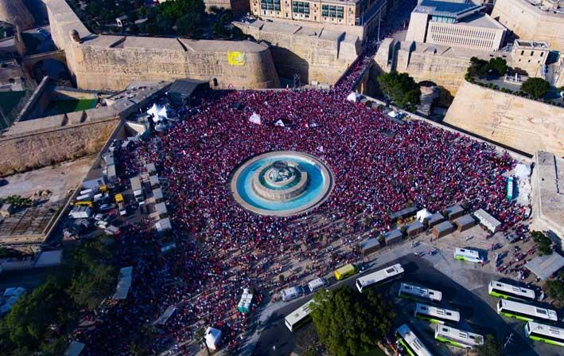

Slide 18
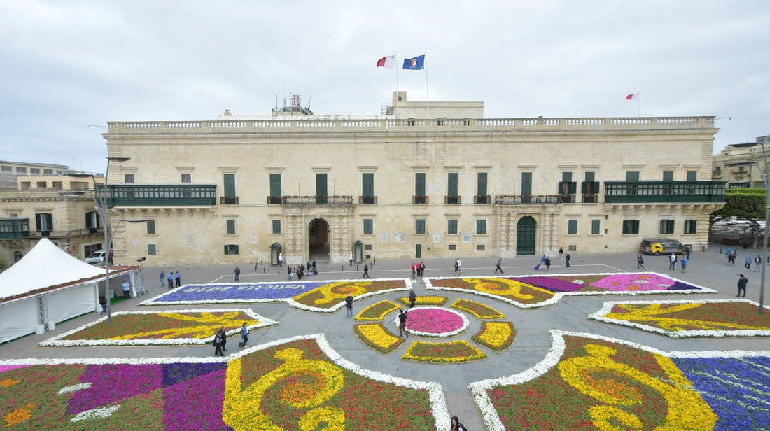

Slide 19
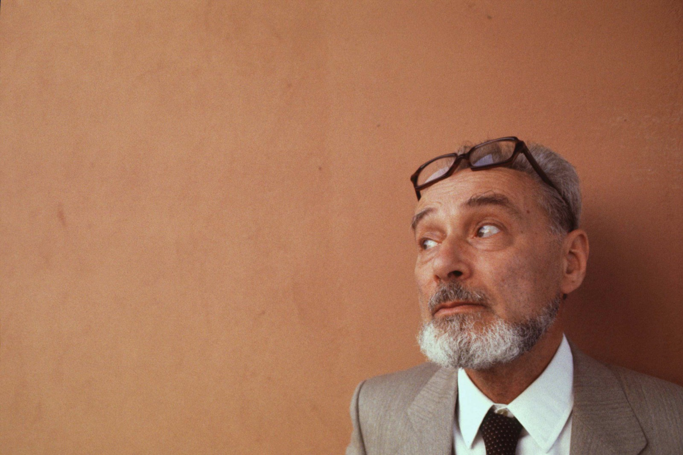

Slide 20

‘Education, knowledge and science sink, today, in a loss of prestige. They can resurface only if they can show they can offer workable, technical and economic solutions. Solutionism is the alibi of a knowledge that has lost the attribution of making us better, as people and as a society. We no longer believe this is possible, and therefore only ask for solutions and more solutions. We do not believe we can improve ourselves, but only gain more or less privileges in a span of time that goes nowhere, because we have given up on aiming for a better future.’

Slide 21


Slide 22

‘And how do you see to your duties, since you are not there?
On the strength of my will, Your Highness, said Agilulfe, and my faith in the holiness of our cause!’

Slide 23
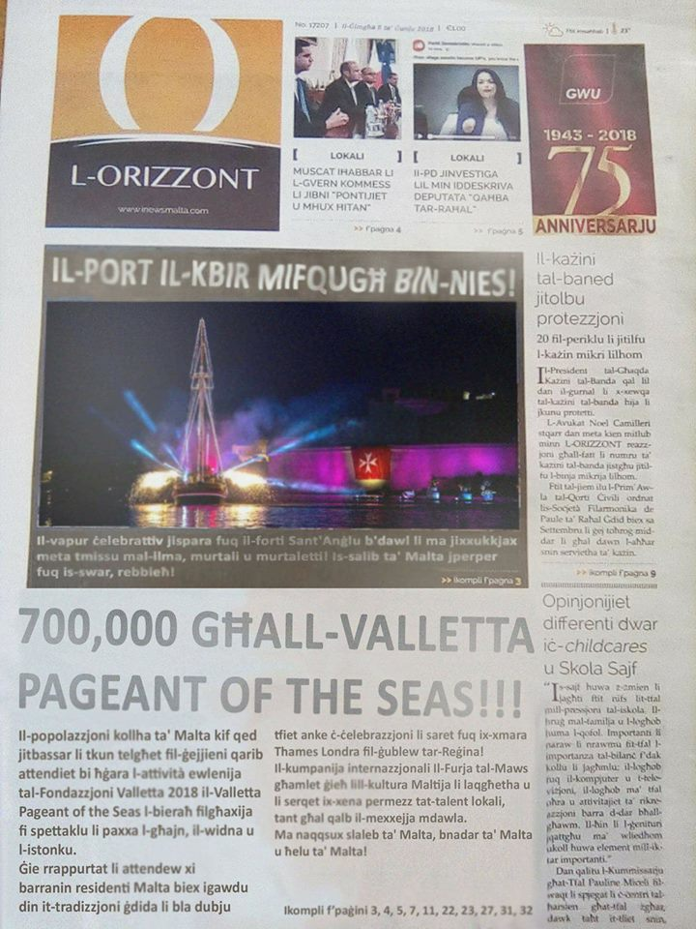

Slide 24
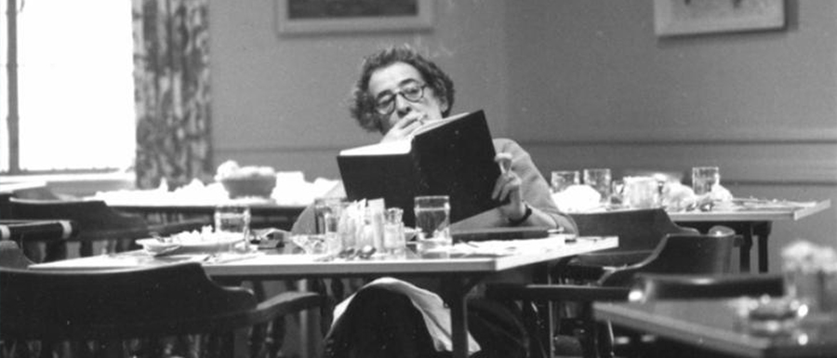

Slide 25
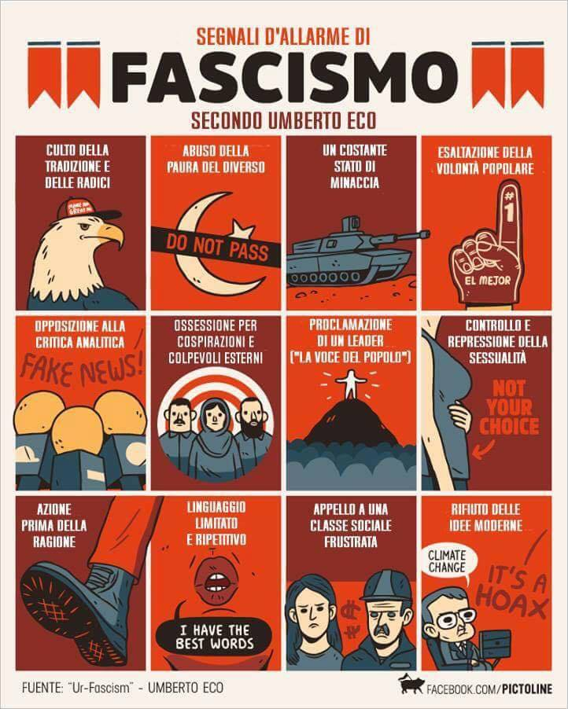

Slide 26
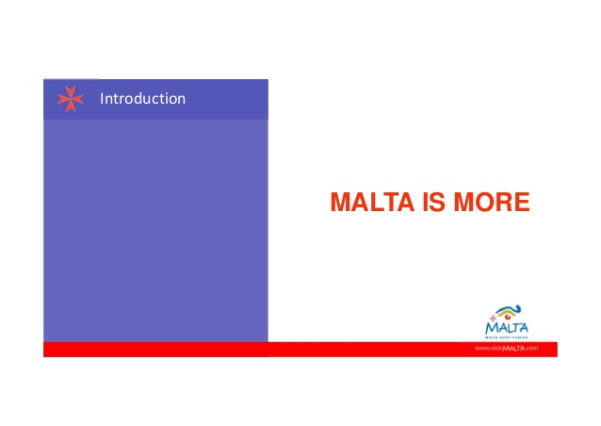

Slide 27


Slide 28
‘What if the predicament is not intestacy, as Arendt suggests, but rather a kind of hyper-testamentarity – not a deficit but a surfeit of testamentary protocol? It is not that the thread has been broken and the family jewels scattered and inaccessible. On the contrary: we are overwhelmed by a surfeit of testamentary material. The past confronts us as a thicket of imperatives, injunctions, promises, exhortations, incitements, excitations – obscure messages from the dead, unsigned and undated but nonetheless time-stamped and indelibly addressed to us. What if the testament itself were the heritage – or rather, if there were no heritage, no patrimonial estate to settle, but only the pressure of a demand as enigmatic as it is insistent?’

Slide 29
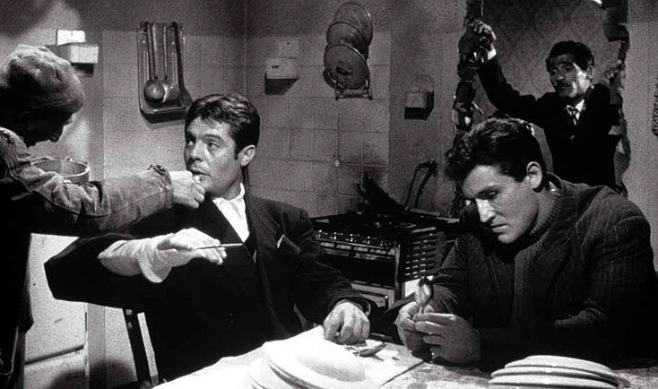

Slide 30
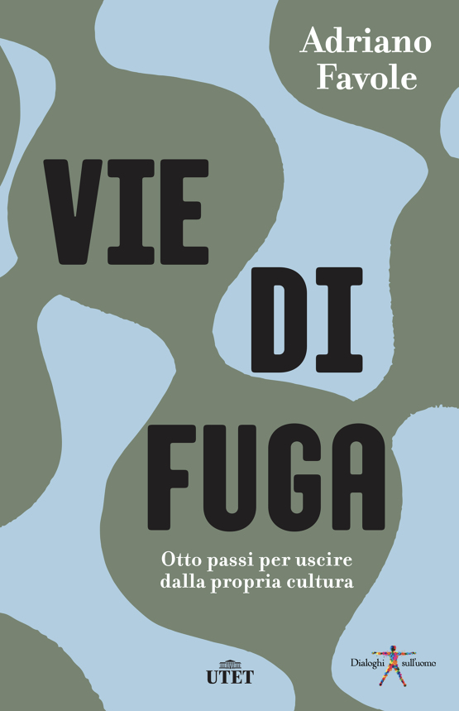
‘human cultures are slightly cross-eyed: with one eye they look at the past and nurture dreams of identity; with the other they look at the future and develop projects’

Slide 31
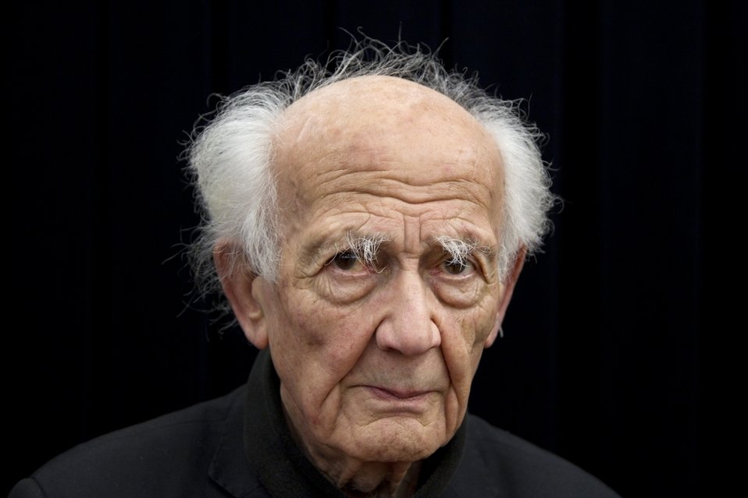

Slide 32
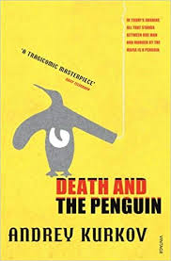
‘This agreeable café interlude, this stop-off between past and future, over cognac and coffee, induced a mood of romance. No longer did he feel lonely or unhappy. He was a valued customer, satisfying a modest demand for inner warmth. A glass of good cognac and already a flow of warmth in contrary directions: up into his head, down into his legs, and a slowing of thought processes.’

Slide 33
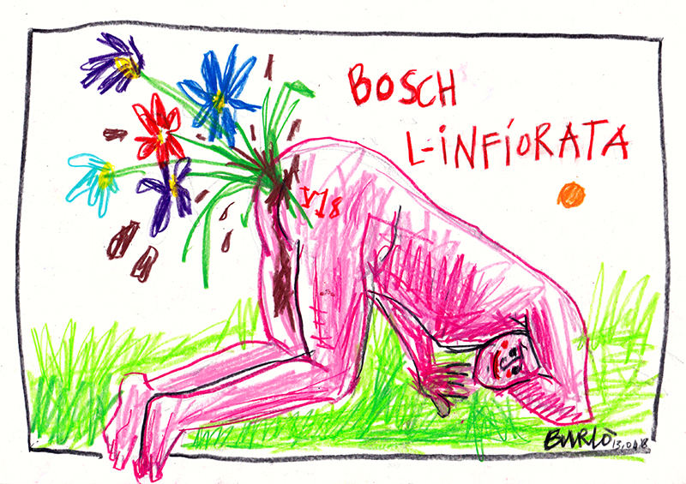

Slide 34
Thank you!
https://culturalpolicy.blog/

