Slide 1
Cultural Exchanges among Mediterranean basin countries
With a focus on Malta as a hub of activity
(‘an environment of exchange’)
Relating to other topics namely Intercultural Communication and Social Changes, Cultural Inclusion, Immigration and Refugees, and Cultural diversity
9th ICCEDA Athens 5 October 2018
Dr Karsten Xuereb
https://culturalpolicy.blog/

Slide 2
In brief
Effective intercultural exchange in the Mediterranean may be of a small scale because sustained and sustainable. My experience with large-scale projects as is balanced out with ones of a smaller, less official and officious, dimension. Research carried out with various cultural operators in the region points out that gaining greater degrees of independence of thought and action, as well as autonomy in entering funding obligations are challenging, yet important in engaging in meaningful and long-term cultural relations. Less, yet better money, may be worth exploring further. Malta may act as an example of a Mediterranean place of cultural confluence or, to quote Prof. Paul Sant Cassia, 'an environment of exchange' (2011). Research into the role of intercultural managers as well as various cultural programmes will be drawn upon.

Slide 3
International micro-environments in the Mediterranean
These places may be described as international micro-environments. The density of diversity brought about by the cultural difference present in people is a key aspect of the field addressed by current research. This is so because the cultural diversity within a group of people, or groups of people, that come together for economic or social reasons to form a larger group with varying degrees of cohesion, recreates an international environment within a local, or micro one. Focusing on the role of cultural operators, identified as intercultural managers, and their work within such contexts, prompts the question, ‘How does the complex relationship between culture and management enable, as well as hinder, intercultural managers to address culturally diverse societies in Europe and the Mediterranean today?’

Slide 4
Theoretical background into intercultural management
The case of Malta is, arguably, an interesting one. It is not unique, but rather reflective, symptomatic, arguably representative, of a larger regional reality. This is so because one may speak of a (i) microcosm within the Mediterranean context, itself a (ii) regional reality in a (iii) global context. While varying social realities exist, through current research I am drawing comparisons between these three levels.

Slide 5
The wider context
It is also worth considering four other aspects in the wider context:
- Globalization, and its contribution to propagate and instil norms and behaviour, particularly related to markets and the movement of people, across different countries and regions of the world;
- Neoliberalism, and the impact of contemporary aspects of liberal thinking, politics, economics and cultural behaviour on the way people from different cultural groups converge in their attempts and struggles to survive and develop as human beings within capitalist societies;
- Migration and integration, as key manifestations of cultural diversity and intercultural exchange among people who are uprooted and seek to start new, settled, improved lives away from their home countries, and
- The arts, as a social reality bringing people together through creative exchange, as well as dividing people on sensitive matters related to ethnicity, religion, censorship or mutual respect.

Slide 6
Intercultural management
Georgescu (2016) posits the development of intercultural management (IM) as a discipline of practice in relation to the dynamics between culture and civilization. A critical approach towards the activity of IM is a keystone of cultural activity, although not an end in itself. This is so if one prioritises the actual action and any possible outcomes before self-referential analysis. Indeed, the aims one sets oneself are fundamental to any cultural activity. There are a number of factors that have contributed to the emergence of IM. They include internationalization and globalization; competition between major international corporations; the free movement of specialists and liberal professions; communication and information technologies; the practice of small and medium enterprises; and the planetary migration of people. There is also the phenomenon described as the ‘flattening’ of culture, consisting of intercultural nodal spaces where languages and cultural original are multiple and mixed.

Slide 7
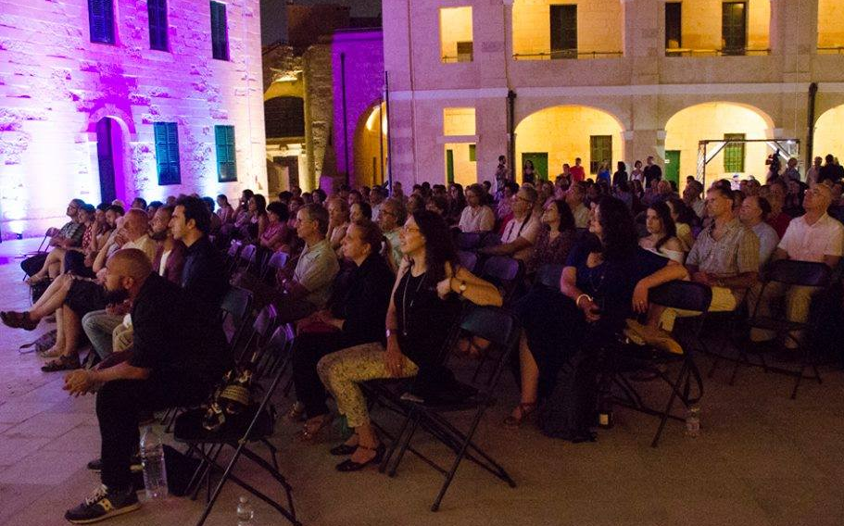

A few practical references to Malta
Inizjamed - Malta Mediterranean Literature Festival

Slide 8
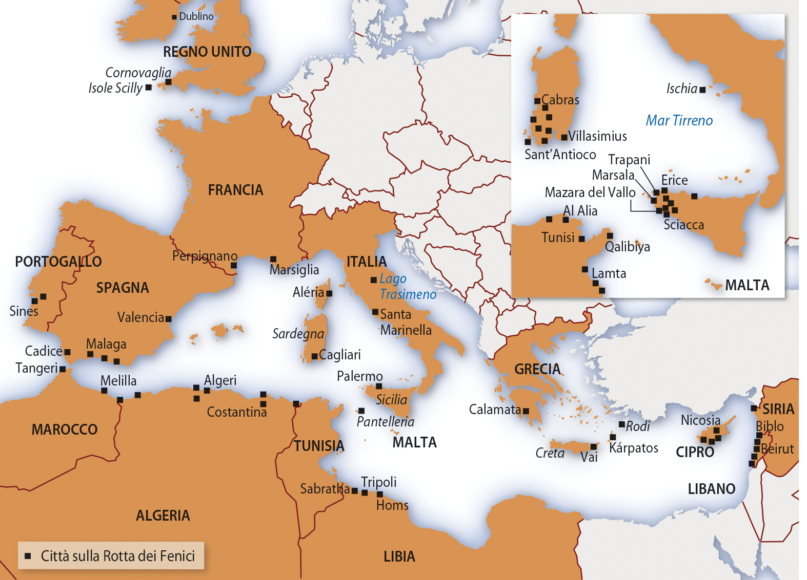

The Phoenicians Route of the Council of Europe Cultural Routes

Slide 9
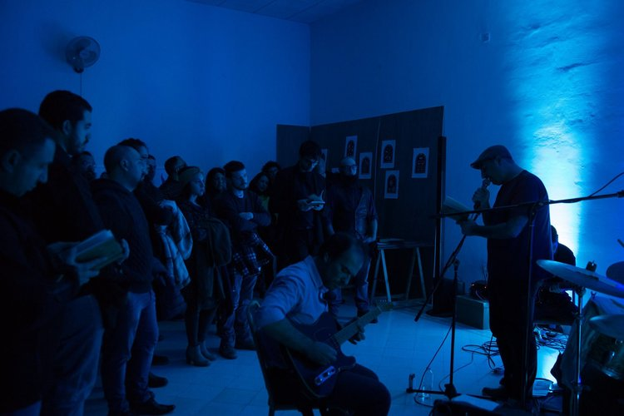
HELA: Hub for Excellence in the Literary Arts

Slide 10
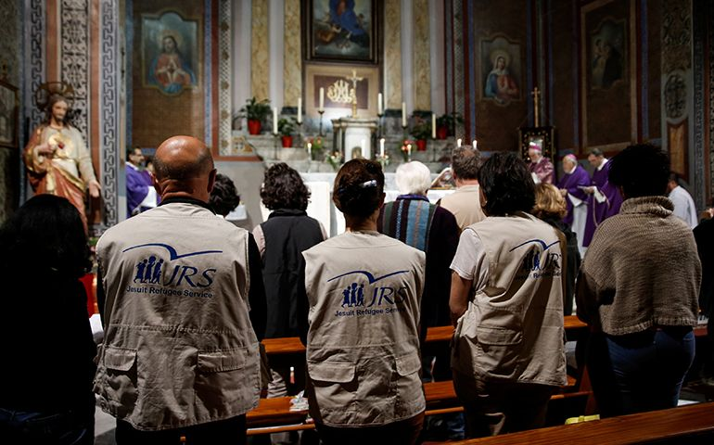
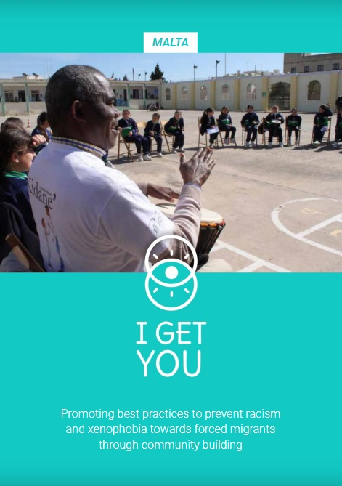
Jesuit Refugee Service - I Get You

Slide 11
Thank you!
https://culturalpolicy.blog/

