Slide 1
“Faith and Culture:
Widening our Horizons”
‘Common Skies, Divided Horizons’*
*I. Chambers and L. Curti (eds.), 1995. The Post-Colonial Question: Common Skies, Divided Horizons, London: Routledge
Dr Karsten Xuereb

Slide 2
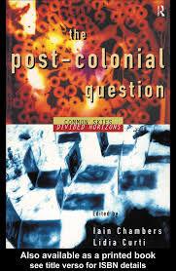
I. Introduction: faith and culture in conflicting horizons

Slide 3
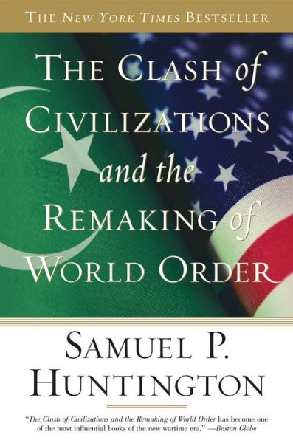

Slide 4


Slide 5
‘It is my hypothesis that the fundamental source of conflict in this new world will not be primarily ideological or primarily economic. The great divisions among humankind and the dominating source of conflict will be cultural. Nation states will remain the most powerful actors in world affairs, but the principal conflicts of global politics will occur between nations and groups of different civilizations. The clash of civilizations will dominate global politics. The fault lines between civilizations will be the battle lines of the future.’
Huntington (1993).

Slide 6
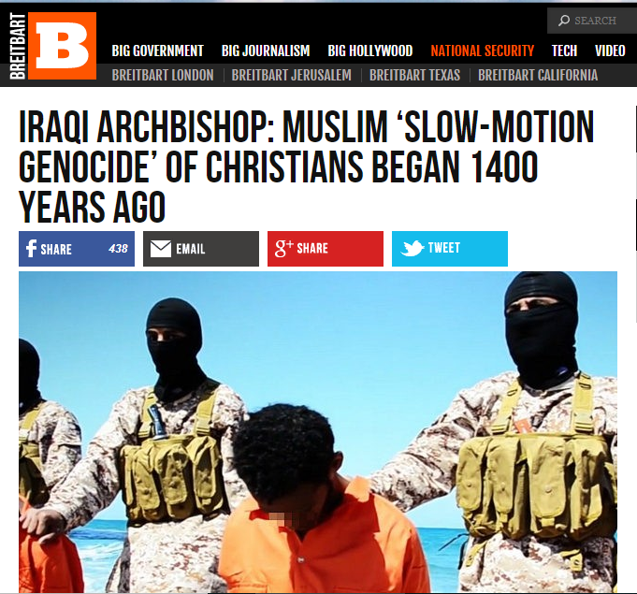

Slide 7
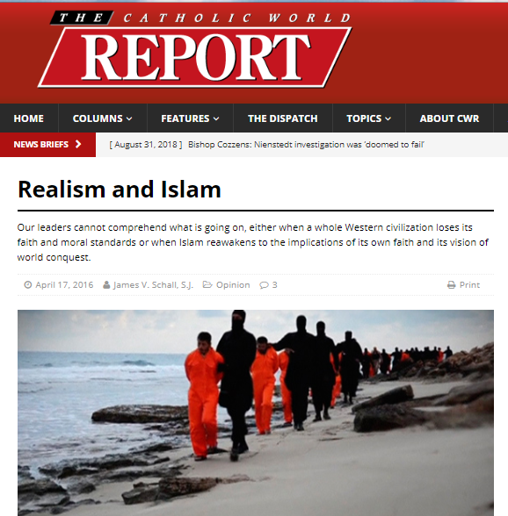

Slide 8


Slide 9
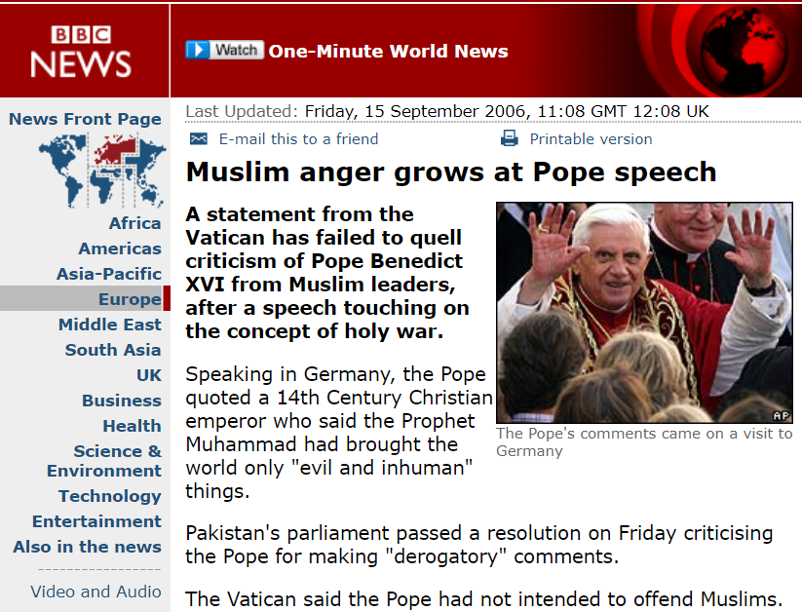

Slide 10
II. Recurring horizons in the Mediterranean space
‘three competing western‐moving religious cults to which the Mediterranean gave birth always meant to adore the same one God; alas how many misdeeds have been committed in his name. They are all, according to the Koran, people of the book (ahl al‐kitab), all pledged religiously to do good and to shun evil. However important it may still be in varying degrees, religion is by no means its sole defining socio‐cultural quality’.
Frendo (2005).

Slide 11


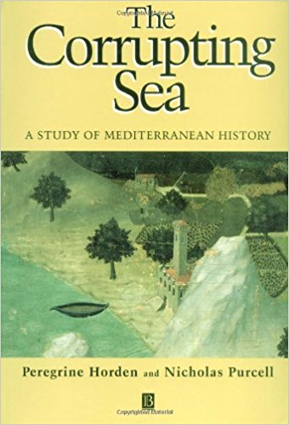

Slide 12
‘Albert Camus may have been dreaming when he saw the Mediterranean as a role model for coexistence, because clearly this sea has been as much of a divider as it has been of a unifier. In a partial critique of Braudel’s more holistic thesis, Horden and Purcell would argue that in the twentieth‐century modernization has had a disintegrating effect.’
Frendo (2005).

Slide 13
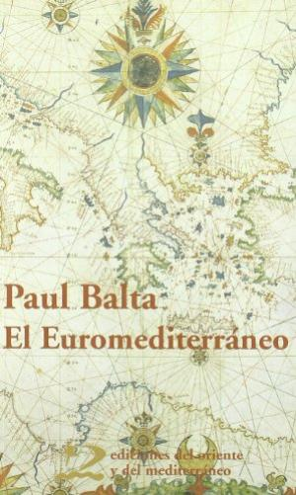

Slide 14
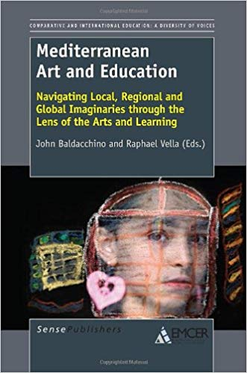

Slide 15
‘Before the longing for a lost past, nostalgia gets from nóstos the notion of homecoming, where what animates the journey is the return – knowing, as Constantine Cavafy tells us in his poetry, that we want to keep the journey going as much as we can, because any sense of return always remains with us. In this we could assume that the narrative of the journey and the polity of doubt come together as the nostalgic return to an end that is historically postponed.’
Baldacchino (2010).

Slide 16
‘In Cavafy, Seferis and Angelopoulos – not to mention Agamemnon and Odysseus – homecoming remains a perennial attachment to the Mediterranean’s aesthetic representation. Yet the image of the exiled is not aesthetical, but profoundly ethical.’
Baldacchino (2010).

Slide 17
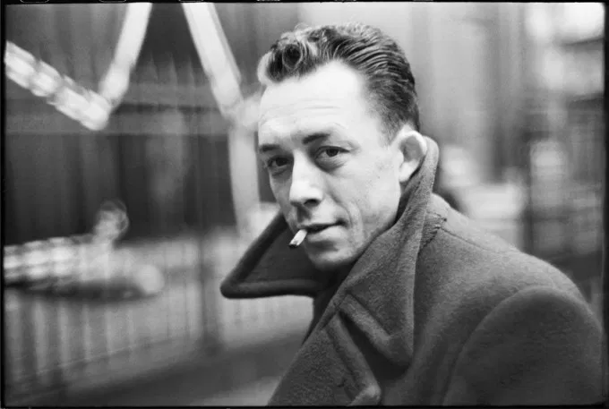

Slide 18
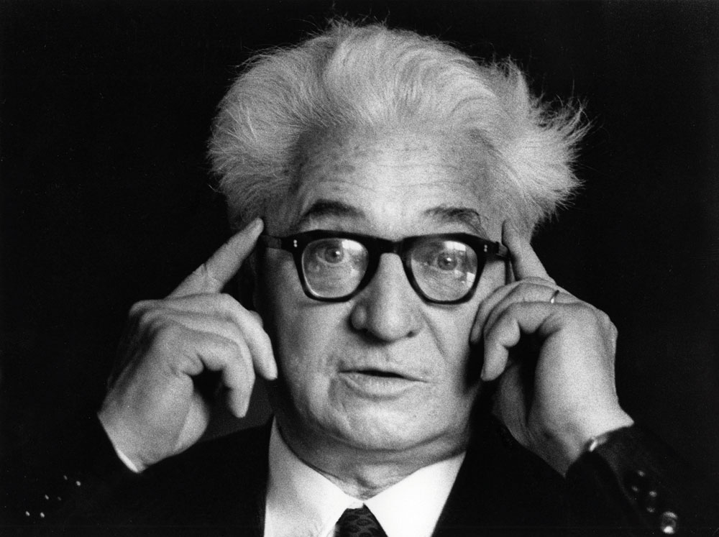

Slide 19
‘[t]o look at history’s horizon is to engage in a continuum that presents itself as a permanent race between Achilles and the tortoise where any argument for a closure of history’s meaning proves to be a fallacy. When it comes to the Mediterranean, the lesson is further radicalized at source: “If the Mediterranean has done no more than force us out of our old habits it will already have done us a service.”’
Baldacchino (2010).

Slide 20

III. Faith and culture: widening horizons

Slide 21
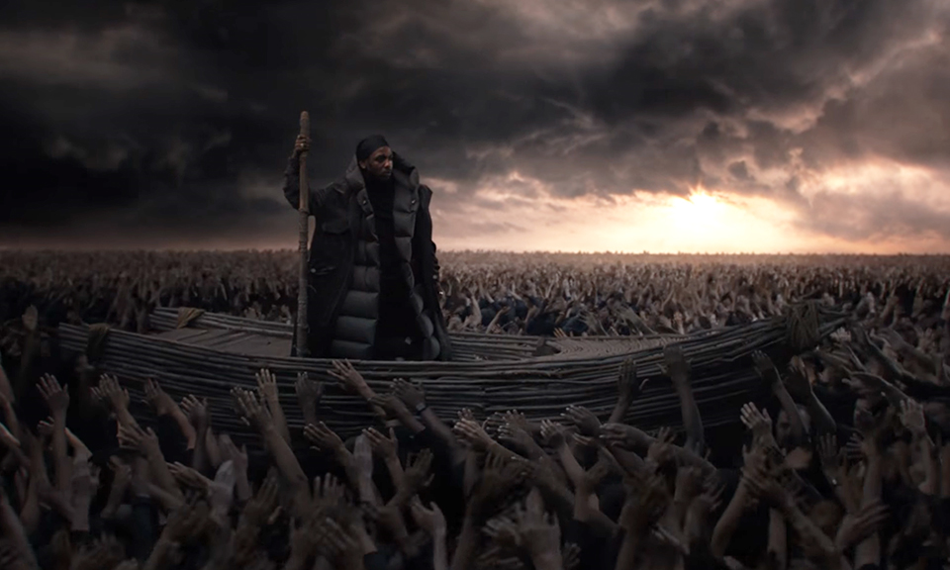

Slide 22
‘Forgotten history, forgotten legacy,
Facts of the past sure can influence our future
‘Fore they can face the truth, my people fades to black
Back against the wall, living in a world in war.
Ignorance the number one cause of death
Knowledge and faith the only wealth worth collecting
Culture saved from the shade, Black slaves finally free.’
Kendrick Lamar (2018).

Slide 23
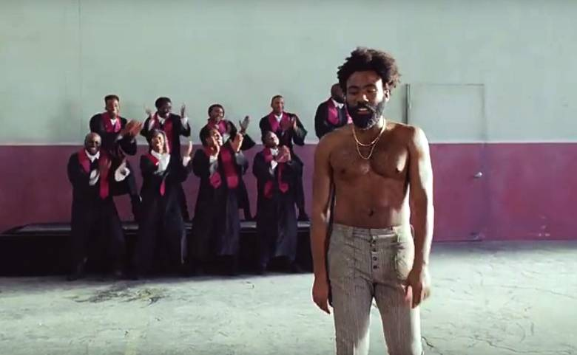
IV. Faith and culture: narrowing horizons

Slide 24
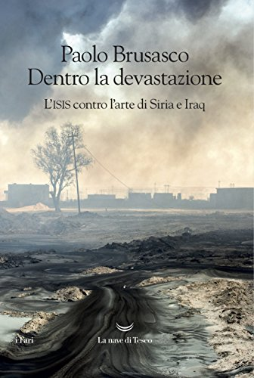

Slide 25
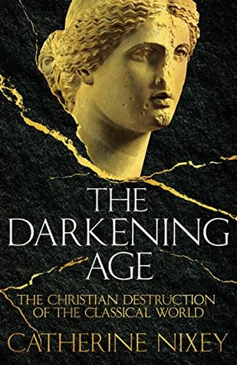

Slide 26

V. In search of a resolution

Slide 27
‘siamo noi, grigi e identici, piccoli come formiche e grandi fino alle stelle, serrati l’uno contro l’altro, innumerevoli per tutta la pianura fino all’orizzonte’
Levi (1958)
‘it is us again, grey and identical, small as ants, yet so huge as to reach up to the stars, bound one against the other, countless, covering the plain as far as the horizon’
Woolf (1959).

Slide 28
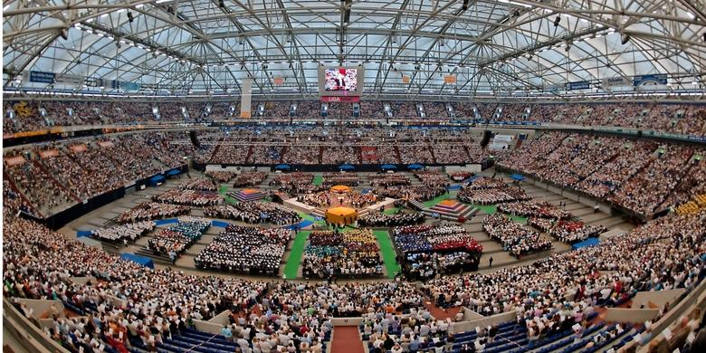

Slide 29
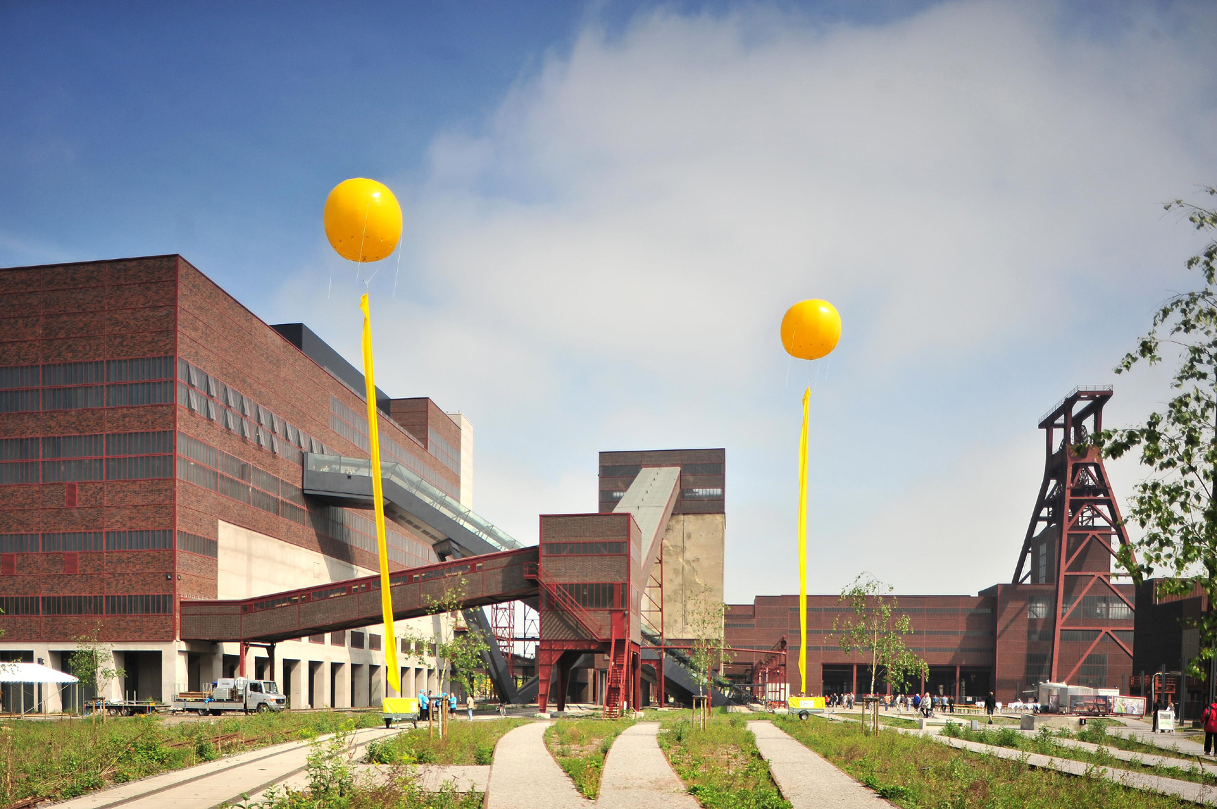

Slide 30
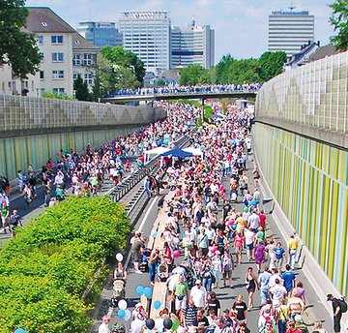

Slide 31
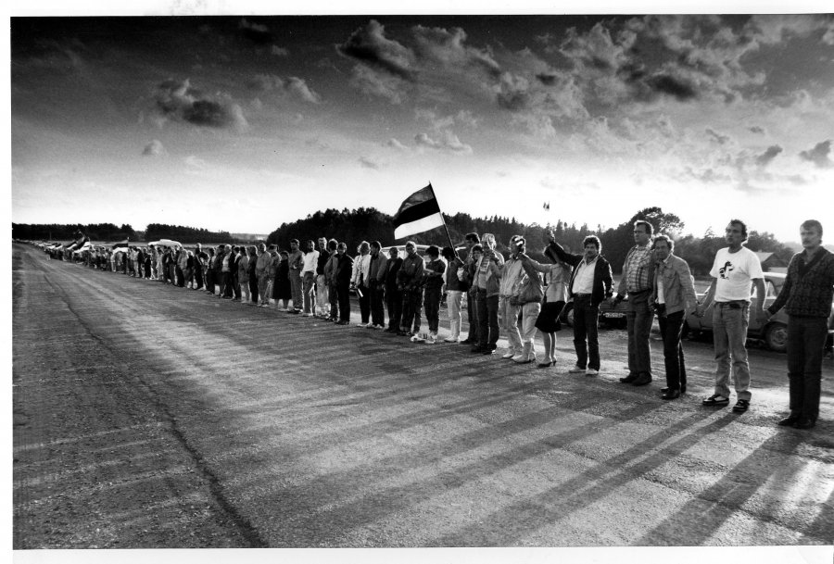

Slide 32
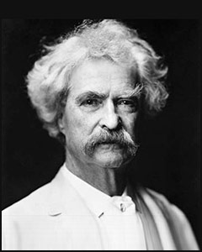
VI. Conclusion: open horizons

Slide 33
‘Whether apparently coming from another world into the one we are most familiar with (but what world now is not in some profound sense also a part of our own, and we of theirs), or emerging within the very languages and streets of ‘our’ cities to disturb or disorient us, the emergence of other voices, desires and bodies reveals a sense of culture and politics, of history and identity, that can no longer be referred to the old myths that once assured us of our presence. Our previous sense of our selves, with its presumptions of centre and of ‘home’, has been irrevocably interrupted’.
Chambers & Curti (1995).

Slide 34
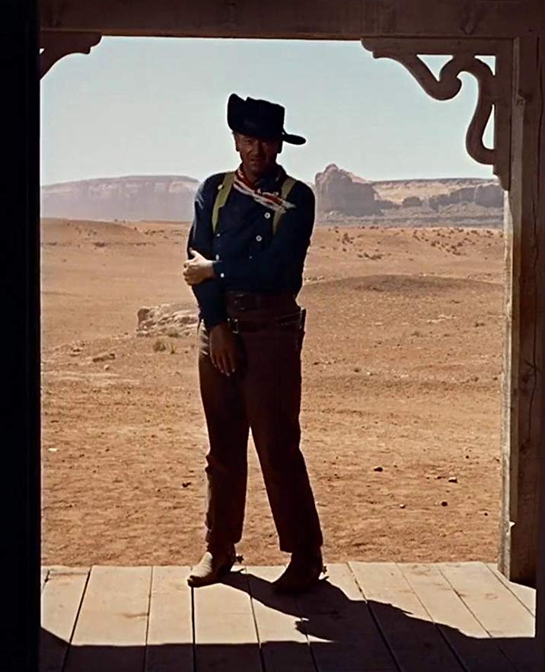

Slide 35
Thank you
https://culturalpolicy.blog/

