Slide 1
Cultural Policy in the Mediterranean
With a focus on Malta
Dr Karsten Xuereb

Slide 2
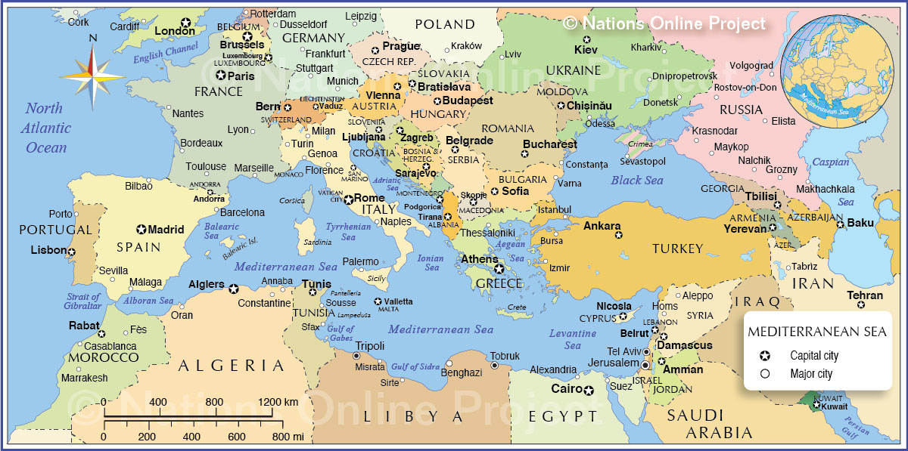
The Mediterranean space
Map of Med

Slide 3
The Mediterranean space
Bringing together different layers of social relations, including:
Historical relations
Political relations
Economic relations
Cultural relations

Slide 4
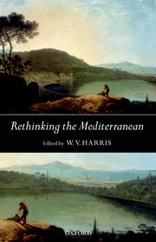
Is the Mediterranean a region?
After Michael Herzfeld in W.V. Harris (2005)

Slide 5
Is the Mediterranean a region?
Yes: particular characteristics, including:
Geography
Environmental challenges
Cross-cultural & religious aspects
No: not coherent or unified:
Politically
Economically
In dealing with challenges

Slide 6
The postcolonial context
Shadow of colonialism on today’s Mediterranean cultural relations
British
French/la francophonie
Other European, global?
Manifest or covert/indirect related to economic development
Culture: can ever be neutral/uncontested?

Slide 7
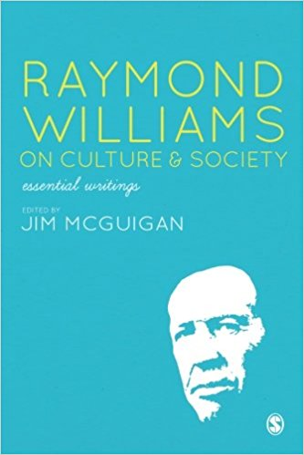
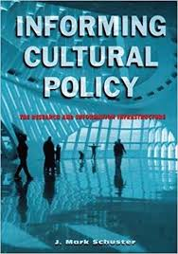
Cultural policy perspectives
Raymond Williams on ‘ordinariness’
J. Mark Schuster (2002)

Slide 8
Where does cultural policy fit in all of this?
Various exercises at mapping cultural policy on regional level, but truly a collection (compendium) of national or sub-national ones
There are supra-national bodies that address cultural policy, including:
EU
Anna Lindh Foundation
Various Euro-Med processes and frameworks (Union for the Mediterranean; EMUNI; UNESCO etc)

Slide 9
Cultural competencies
Competencies: what you can do with different tools
Cultural competencies: in the EU, national competencies, international collaboration, international funding, also with third countries through protocols
Non-EU: national, seek collaboration with EU, and funding

Slide 10
Main aims of cultural policy
Policy-setting to achieve particular goals:
Social:
Wellbeing
Inclusion
Educational
Economic:
Employment
Regeneration

Slide 11
Policy in the Mediterranean today
Strong link with regeneration of urban spaces:
E.g. European Capital of Culture, Arab Capital of Culture
Strong link with tourism through:
History
Heritage (tangible and intangible)
Events
Contemporary culture

Slide 12
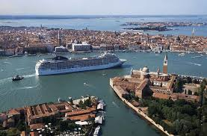
Venice as a case study
Enter image Venice with cruise liner

Slide 13
Venice as a case study
The medieval and early Renaissance regional powerhouse of Venice still attracts attention by:
Capturing people’s imagination through historical references
Combining past with present through contemporary manifestations in historical venues that have been regenerated
E.g.: Venice Biennale (art, architecture, film)
Strong point: visibility, familiarity, still innovating
Weak point: resting on laurels? Others quicker? (Pierluigi Sacco)

Slide 14
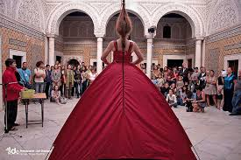
Tunis as a case study
Enter Tunis image: Sidi Bousaid?

Slide 15
Tunis as a case study
Tunisia dealing with effects of global Islamic terrorism e.g. Bardo and Sousse attacks in 2015 leading to collapse of tourism industry
Cultural initiatives supporting foreign investment and international collaboration e.g. Dream City
Strong point: young population, potential for education and employment
Weak point: terrorism threat, economy slow

Slide 16
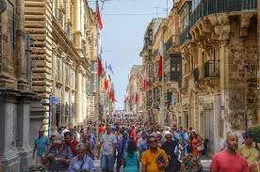
Malta as a case study
Enter image of Malta (Valletta)

Slide 17
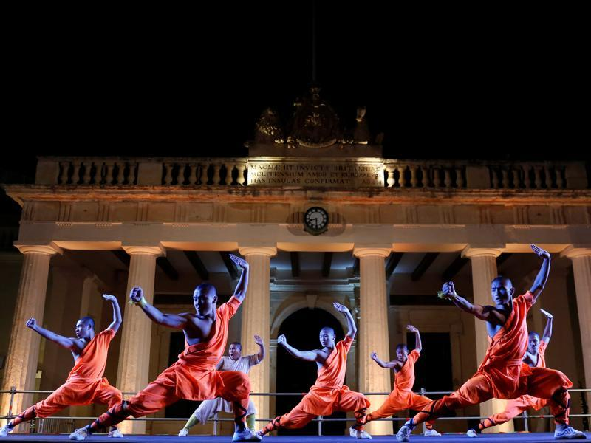
Malta as a case study
Enter picture of China presence in Valletta: PTR or St James

Slide 18
Malta as a case study
Relatively young nation: 1964
Rich colonial past, but also heavy on heritage: ‘living on a monument’ (Jon. P. Mitchel 2012; common to Mediterranean heritage cities, like Rome)
Struggles to manage different currents, and resulting tensions:
Population growth
Tourism
Environmental impact
Cultural identities

Slide 19
Malta as a case study (2)
The strong financial and economic scenario helps make investment available
But legacy- and sustainability-thinking lacking
Biggest losers: environmental matters, urban planning, poverty divide, lack of strategic development
Cultural policy: effective to address these matters, but is it its role?

Slide 20
Malta as a case study (3)
Cultural policy should not be a substitute for education, social and environmental policies
To contribute to society, cultural policy needs a few elements, including:
Arm’s length and professional governance
Enabling routes to funding/sponsorship (fishing rod better than basket of fish)
Capacity building
International networking
Long-term vision

Slide 21
Conclusion
Cities in the Mediterranean are developing a strong identity: e.g. territorial diplomacy
Challenges are common: educational, environmental, social, urban
Censorship: political, economic, other?
Opportunity: young populations, migrant populations, technology

Slide 22
One final thing: a visual representation of Malta
Trailer from the film Simshar
Not many indigenous films in Malta
Film industry is more of a service industry
Local realities that resonate with regional and global ones: migration, religion, social tensions, economic challenges

Slide 23
Thank you!
https://culturalpolicy.blog

